Slide 1
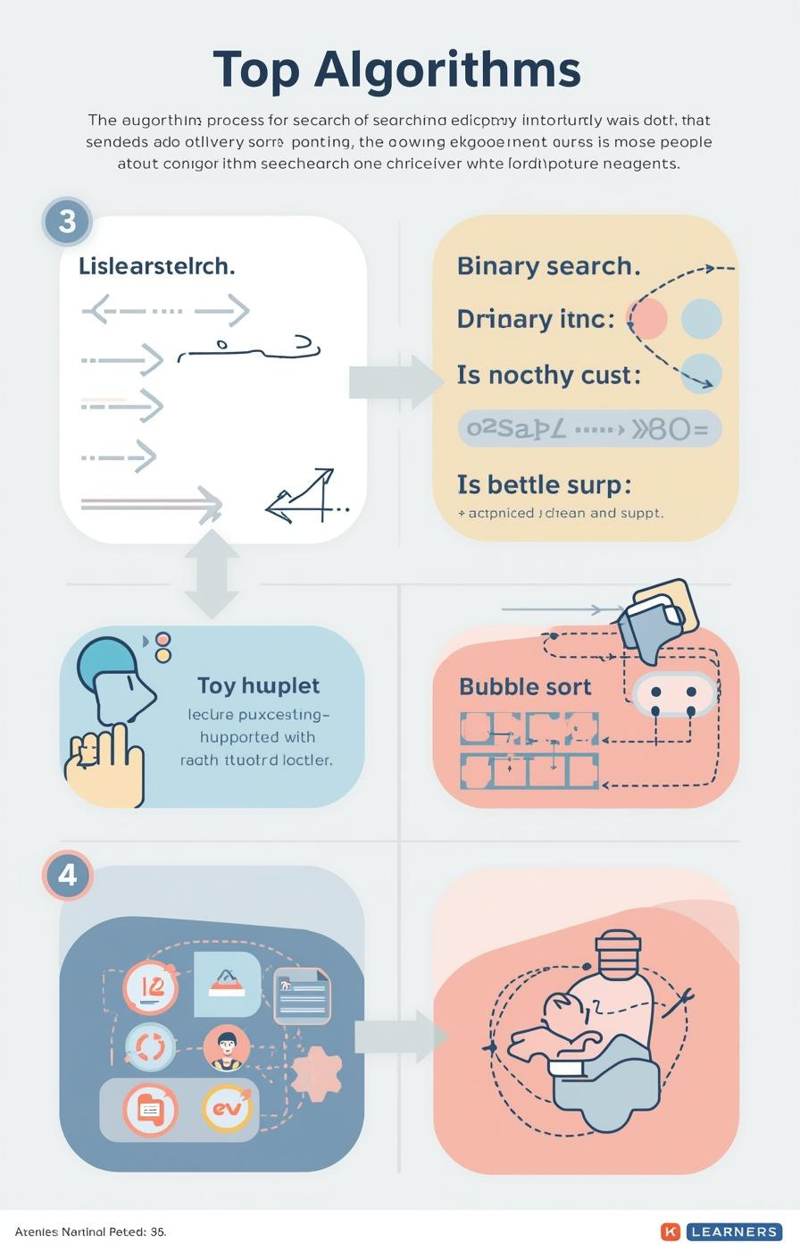

Algorithms: Searching and Sorting
by Mr. Edward Paul

Slide 2

Understanding Algorithms
Their Importance in Computer Science
Algorithms are essential, defined as step-by-step procedures for solving problems. They enable computers to efficiently process information, making them a fundamental aspect of computer science and programming.
2

Slide 3

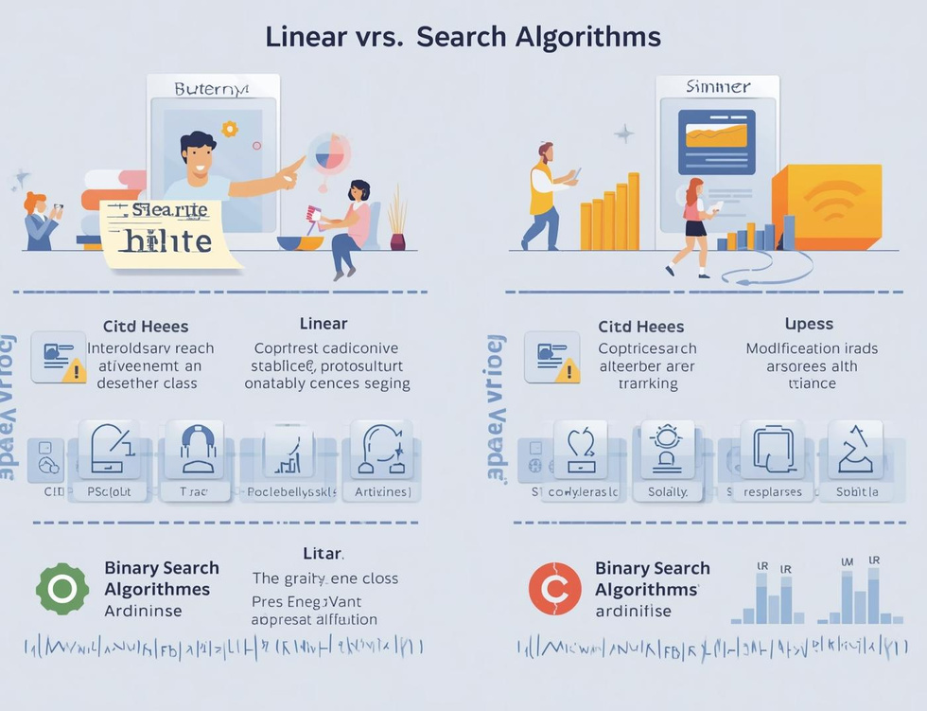
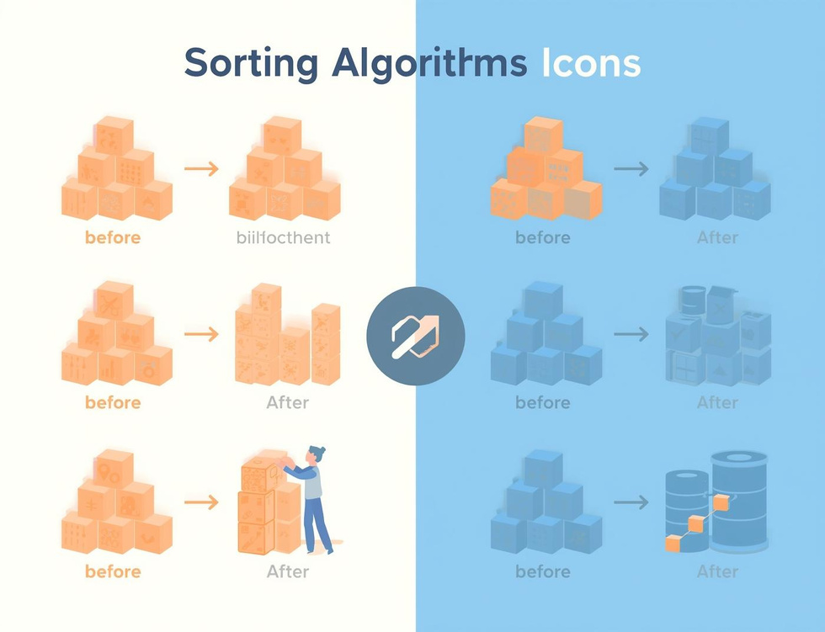
Learning Objectives
Search Algorithms
Compare Efficiencies
Bubble Sort
Understand how algorithms locate data effectively through different searching techniques.
Learn the efficiency differences between linear and binary search methods in data retrieval.
Understand the basics of bubble sort and how it organizes data through comparisons.

Slide 4
Linear Search
Sequential Scanning for Data Retrieval
Definition
Simple Mechanism
Use Cases
Linear search is a straightforward algorithm that checks each element in a list sequentially until it finds the target value or reaches the end of the list.
This method is easy to implement but can be inefficient for large datasets, as it might require examining every single item before locating the desired information.
Linear search is particularly useful for small or unsorted datasets where quick implementation is necessary, making it an ideal choice for simple search tasks.
4

Slide 5
Binary Search
Divide and Conquer Method Explained
Definition
Mechanism
Requirements
Binary search is a fast search algorithm that finds the position of a target value within a sorted array, using a divide-and-conquer strategy for efficiency.
The algorithm repeatedly divides the search interval in half; comparing the target value to the middle element, it narrows down the potential location until the target is found.
For binary search to work, the data must be sorted beforehand; this prerequisite allows the algorithm to efficiently eliminate half of the remaining elements with each comparison.
5

Slide 6

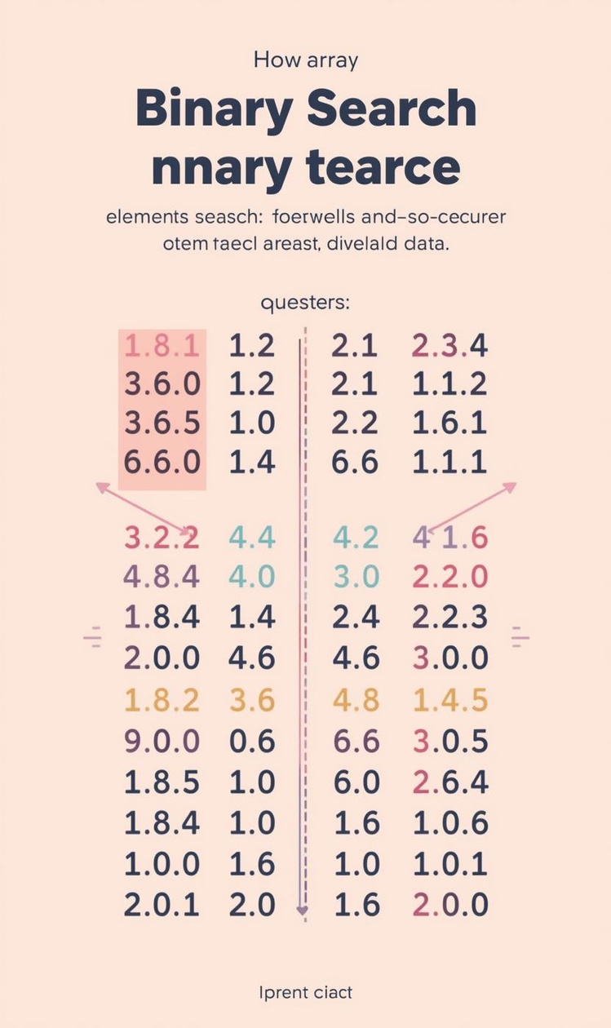

Comparing Efficiency of Search Algorithms
Efficiency
Pros and Cons
Linear search has O(n) time complexity.
Binary search is faster but needs sorted data.

Slide 7
Algorithm Tracing
Linear Search
Binary Search
Efficiency Comparison
In linear search, each element is examined sequentially until the target is found. This straightforward approach is effective for small or unsorted datasets, but can be slow for larger lists.
Binary search requires a sorted list, dividing the search space in half repeatedly, which drastically reduces the number of checks needed to find the target value, making it more efficient than linear search.
Comparing the two searches, linear search has a time complexity of O(n), while binary search operates at O(log n), highlighting the significant efficiency gained through the divide-and-conquer strategy of binary search.

Slide 8
Bubble Sort
Introducing Sorting Algorithms and Their Importance
8

Slide 9
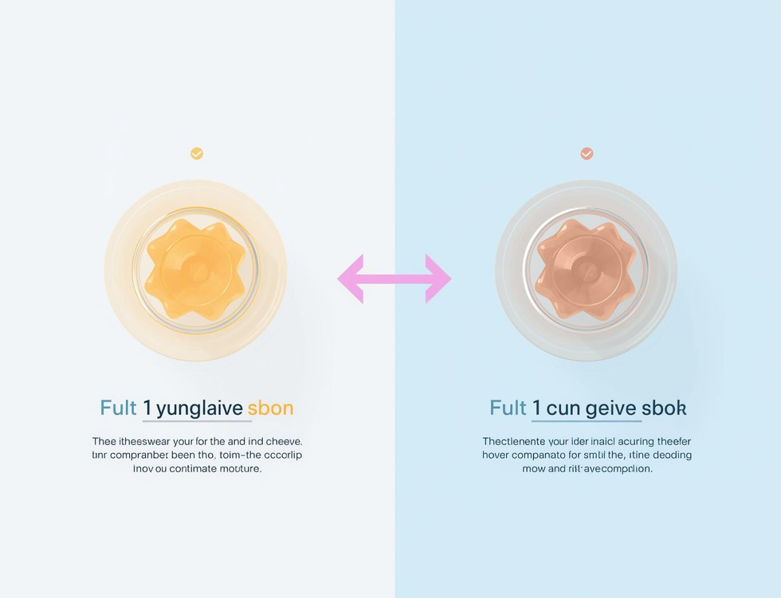

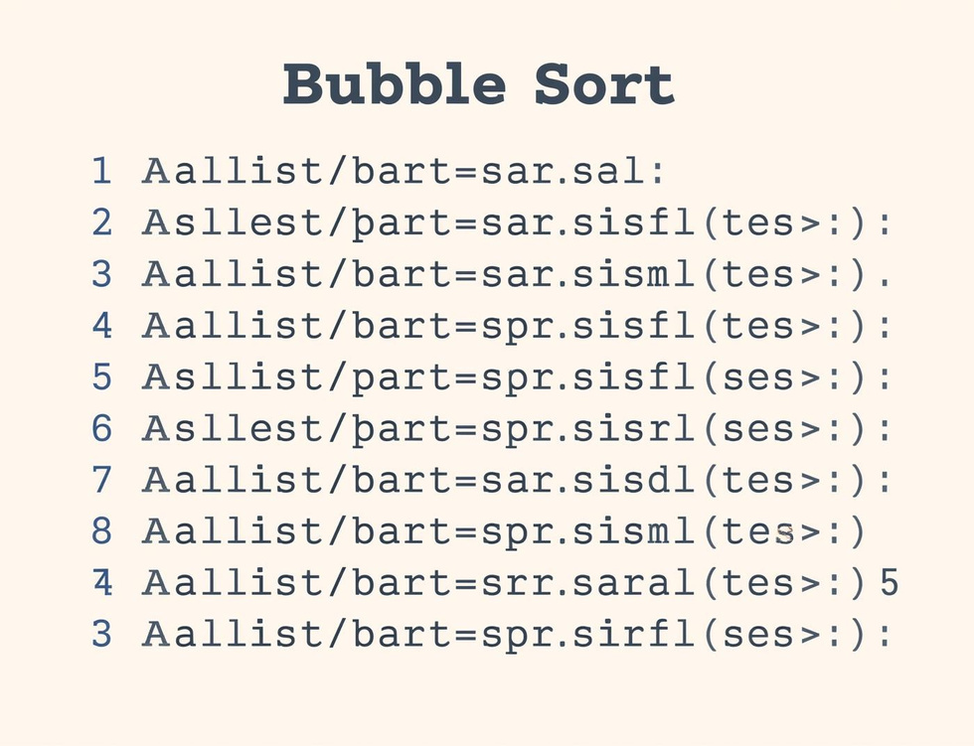
Bubble Sort Steps
Compare Elements
Swap if Needed
Repeat Passes
Compare adjacent elements to determine if they need swapping for sorting.
Elements are swapped if they are in the wrong order, ensuring sorting progress.
The sorting process continues with repeated passes until the entire list is sorted.

Slide 10
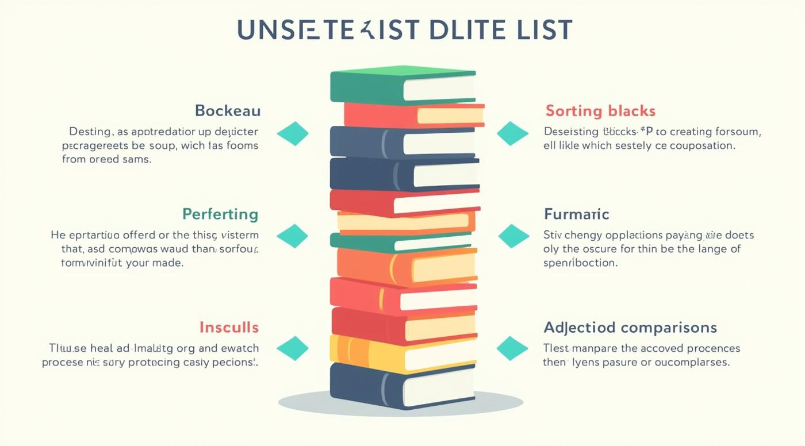
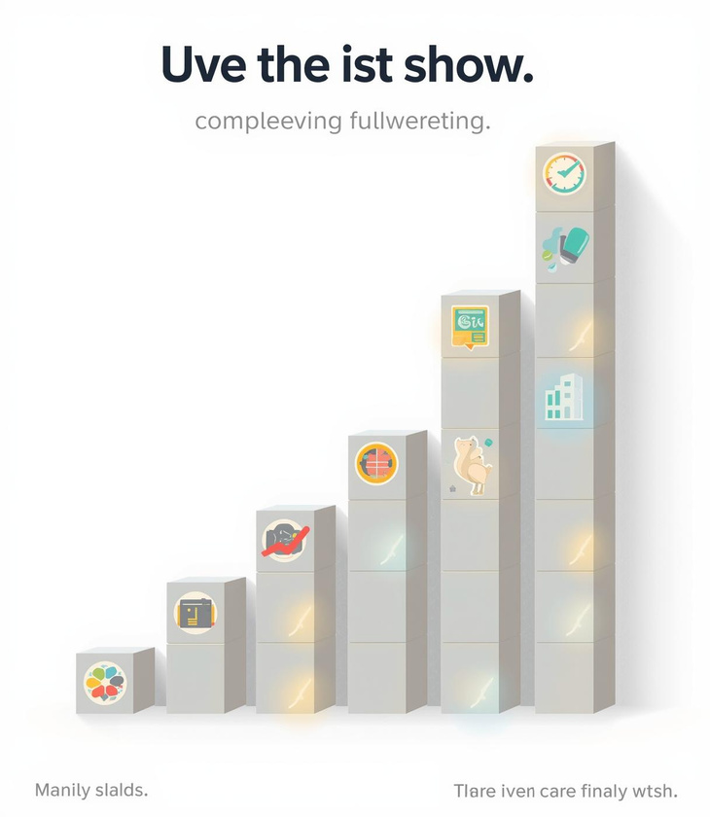
Tracing Bubble Sort Steps

Slide 11
Key Takeaways and Insights
01
Search Algorithms
Linear and binary searches each have distinct strengths.
02
Sorting Concepts
Bubble sort is an essential foundational sorting algorithm.
03
Tracing Importance
Understanding algorithms requires step-by-step tracing practice.

Slide 12

Continue Learning
Practice tracing algorithms today!

Slide 13
Lesson on Algorithm - Year 3
AI-Generated Teaching Slides

Slide 14
Okay, this is going to be a fun one! Algorithms for Year 3 need to be hands-on,
---
## Lesson Pack: Algorithms - Year 3
**Topic:** Introduction to Algorithms
**Target Age:** Year 3 (7-8 years old)
**Duration:** 45-60 minutes
---
### 1. Lesson Objectives
By the end of this lesson, students will be able to:
* **I can explain** what an algorithm is in my own words (a set of instructions to do something).
* **I can identify** examples of algorithms in everyday life.
* **I can understand** why the order of instructions in an algorithm is important.
* **I can create** a simple algorithm for a common task.
---
### 2. Introduction / Starter Activity (10 minutes)
**Title:** "Jumbled Up Morning!"
**Activity:**

Slide 15
**Teacher:** "Good morning, everyone! Imagine you've just woken up. What's the v

Slide 16
**Teacher:** Show a set of large picture cards (or write on the board) with comm
* Brush teeth
* Eat breakfast
* Get dressed
* Wake up
* Pack school bag
* Put on shoes

Slide 17
**Task:** Ask students, individually or in pairs, to put the steps in the correc

Slide 18
**Discussion:**
* "Why is it important to do these things in a certain order?" (e.g., "If I put my shoes on before my socks, that would be silly!").
* "What happens if you miss a step?" (e.g., "Oh no, I forgot to put on my uniform!").
* **Introduce the term:** "These steps, done in a special order to get something done, are just like what we call an **algorithm** in computing!"
---
### 3. Key Teaching Points (10 minutes)
**Key Concept 1: What is an Algorithm?**
* **Definition:** An algorithm is a set of clear, step-by-step instructions that tell you (or a computer!) how to complete a task or solve a problem.
* **Analogy:** Think of it like a recipe for baking a cake, or instructions for building a LEGO model. If you follow the steps exactly, you'll get the right result!
* **Teacher Example:**
* "How to make a jam sandwich." (Write simple steps on the board).
1. Get two slices of bread.
2. Get some butter/margarine.
3. Get some jam.
4. Spread butter on one side of each slice of bread.
5. Spread jam on one buttered side.
6. Put the two slices of bread together (jam side facing buttered side).
7. Enjoy!
**Key Concept 2: Why is Order Important?**
* **Teacher asks:** "What would happen if I tried to spread the jam before getting the bread? Or if I put the bread together before spreading the jam?"
* **Explanation:** The order (or **sequence**) of instructions is super important. If you mix up the order, the algorithm won't work, or you might get a very different (and perhaps messy!) result. Computers follow instructions *exactly* in the order they are given.
**Key Concept 3: Clear Instructions**
* **Teacher asks:** "What if my sandwich instruction said 'Get some stuff'? Would that be helpful?"
* **Explanation:** Instructions need to be very clear and specific, so anyone (or any computer!) can follow them without getting confused. Avoid vague words.
---
### 4. Guided Practice or Activities (20 minutes)
**Activity 1: "Make a Drink" Algorithm Challenge (10 minutes)**
* **Materials:** Picture cards for making a simple drink (e.g., a cup of water, cordial/juice, spoon). Alternatively, just use the written instructions and a pretend setup.
* **Setup:** Divide students into small groups or pairs. Give each group a jumbled set of picture cards showing the steps to make a specific drink (e.g., a glass of cordial).
* *Example Steps (jumbled):* Put a spoon in the cup. Pour water into the cup. Get a cup. Stir the drink. Pour cordial into the cup.
* **Task:** Each group must arrange their cards in the correct sequential order to make the drink.
* **Teacher Role:** Circulate, observe, and ask guiding questions: "Why did you put that step there?" "What would happen if you did that step first?" "Are your instructions clear enough for a robot to follow?"
* **Extension (if time/resources allow):** Have one group read out their algorithm, and another group 'act it out' like robots, following *only* the given instructions. This highlights the need for clarity.
**Activity 2: "Draw a Monster" Algorithm (10 minutes)**
* **Materials:** Blank paper and pencils for each student.
* **Setup:** Pair students up. One student is the "Algorithm Creator" and the other is the "Robot Artist."
* **Task:**
1. The Algorithm Creator secretly draws a simple monster or alien on their paper (e.g., a circle body, two square eyes, three wiggly arms, a triangle mouth). They must *not* show their partner.
2. The Algorithm Creator then writes or verbally gives a step-by-step algorithm to their Robot Artist partner, instructing them how to draw the monster. They must use clear, precise language.
* *Example instruction:* "Draw a large circle in the middle of your paper." (Not "Draw a body").
* *Example instruction:* "On the top of the circle, draw two small square shapes for eyes." (Not "Add eyes").
3. The Robot Artist must follow the instructions *exactly* as given, without asking clarifying questions (unless specifically allowed by the teacher for learning).
* **Discussion:** After both partners have finished:
* Compare the original monster with the drawn monster.
* "What happened?" "Was your algorithm clear enough?" "What instructions could have been better?" "Did the order matter?"
* This activity powerfully demonstrates the importance of both sequence and clear, unambiguous instructions.
---
### 5. Assessment Ideas
* **Observation (Formative):**
* During "Jumbled Up Morning": Can students logically sequence steps?
* During "Make a Drink" activity: Do groups successfully order the steps? Are they discussing the importance of sequence?
* During "Draw a Monster": How clear are the algorithms created? Do students follow instructions accurately?
* **Exit Ticket (Summative, 5 minutes):**
* On a small piece of paper, ask students to complete one of these sentences:
* "An algorithm is..."
* "One algorithm I use every day is..."
* "Why is order important in an algorithm? Because..."
* **"Fix the Algorithm" Challenge (Extension/Homework):**
* Provide a short, deliberately flawed or jumbled algorithm (e.g., "How to get ready for playtime" with steps out of order or missing). Ask students to rewrite it correctly.
---
### 6. Summary / Conclusion (5 minutes)
* **Recap:** "So today we learned about algorithms! What's the most important thing to remember about an algorithm?" (A set of instructions, steps, order matters, clear!)
* **Real-World Connection:** "Where else do you think we see algorithms in real life?" (Playing a board game, following directions to a friend's house, instructions for making toast, rules for football).
* **Teacher:** "Computers are very good at following algorithms, but only if we give them really clear, step-by-step instructions in the right order. You've all been amazing algorithm experts today!"
* **Challenge Question:** "Can you think of an algorithm we use in school every day?" (e.g., lining up, packing away, getting ready for home time).
---
### 7. PowerPoint Slide Outline
**Slide 1: Title Slide**
* **Title:** Algorithms for Year 3!
* **Subtitle:** Step-by-Step Instructions
* *Image idea: A friendly robot, or a sequence of simple icons (e.g., arrow pointing to different steps)*
**Slide 2: What Will We Learn Today?**
* **Title:** Our Learning Adventure!
* **Bullet Points:**
* What is an algorithm?
* Find algorithms all around us!
* Understand why order matters.
* Create our own algorithms.
* *Image idea: A treasure map or pathway with milestones.*
**Slide 3: Starter Activity: Jumbled Up Morning!**
* **Title:** Can You Get Ready?
* **Bullet Points:**
* Look at these morning routine pictures.
* Put them in the right order!
* What happens if the order is wrong?
* *Image idea: The jumbled picture cards from the starter activity.*
**Slide 4: What IS an Algorithm?**
* **Title:** Algorithms Are Instructions!
* **Bullet Points:**
* An **algorithm** is a set of clear, step-by-step instructions.
* It tells you (or a computer!) how to do something.
* Think of it like a recipe or building instructions!
* *Image idea: A simple recipe card, or IKEA instructions.*
**Slide 5: Why Does Order Matter?**
* **Title:** Order, Order, Order!
* **Bullet Points:**
* The **sequence** (order) of steps is super important.
* If you get the order wrong, it might not work! (Or get messy!)
* Computers follow instructions *exactly* in the order you give them.
* *Image idea: A cartoon showing a disaster trying to make a sandwich in the wrong order.*
**Slide 6: Activity 1: Make a Drink Algorithm**
* **Title:** Robot Drink Makers!
* **Bullet Points:**
* In your groups, you have pictures to make a drink.
* Put the steps in the correct order.
* Think: If a robot followed these, would it work?
* *Image idea: Jumbled pictures of making a drink.*
**Slide 7: Activity 2: Draw a Monster Algorithm**
* **Title:** Draw Your Monster!
* **Bullet Points:**
* Partner 1: Draw a secret monster.
* Partner 2: Listen carefully and draw what you hear!
* Partner 1: Give very clear, step-by-step instructions.
* *Image idea: A blank paper and a pencil, maybe a funny monster drawing.*
**Slide 8: Sharing Our Algorithms**
* **Title:** Let's Share & Compare!
* **Bullet Points:**
* How did your monster drawing turn out?
* What made a good, clear instruction?
* Did the order of steps make a difference?
* *Image idea: Speech bubbles, happy/confused faces.*
**Slide 9: Algorithm Challenge!**
* **Title:** Where Else Do We See Algorithms?
* **Bullet Points:**
* Can you think of any other algorithms we use every day?
* (Examples: Brushing teeth, playing a game, walking to school).
* *Image idea: Icons representing different daily activities.*
**Slide 10: What We Learned Today!**
* **Title:** You Are Algorithm Experts!
* **Bullet Points:**
* An algorithm is a set of clear instructions.
* Order (sequence) is very important!
* We use algorithms all the time!
* *Image idea: A checklist with ticks, or a star badge for "algorithm expert."*
**Slide 11: Exit Ticket**
* **Title:** Quick Check!
* **Bullet Points:**
* On your paper, finish one sentence:
* "An algorithm is..."
* "One algorithm I use every day is..."
* "Order is important because..."
* *Image idea: A thought bubble or a small notebook.*
**Slide 12: Well Done, Everyone!**
* **Title:** Great Work Today!
* **Bullet Points:**
* You are all amazing algorithm thinkers!
* See if you can spot more algorithms this week!
* *Image idea: Cheerful kids, a "well done" graphic.*

